Slide 1
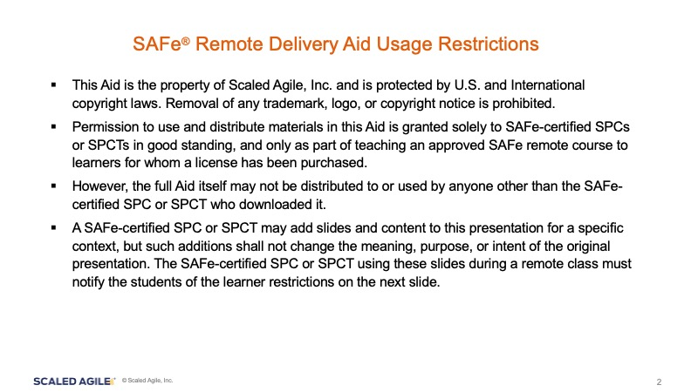

Slide 2
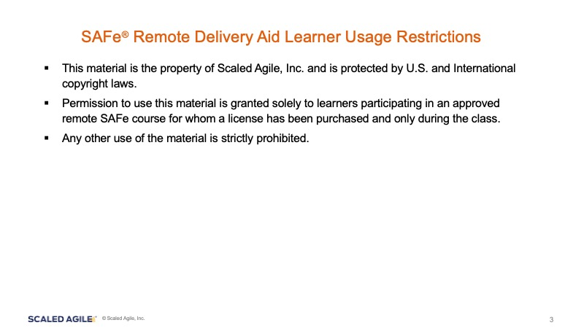

Slide 3
SAFe Release Train Engineer 5.0
Remote Training Aid
Central Class Slides

Slide 4
Virtual Room Dial ins
Group A
Extra Room
Group B
Extra Room
Video LINK
LINK
Video LINK
LINK
Document LINK
Document LINK
Extra Room
Central Room
LINK
Extra Room
Video LINK
Extra Room
LINK
Document LINK
LINK
Extra Room
LINK
Group C
Group D
Video LINK
Video LINK
Document LINK
Extra Room
Document LINK
Extra Room
LINK
LINK
Notes:
Trainer Guidance:
Insert video conferencing and collaboration links.

Slide 5
Group Formations
Group A | Group B | Group C
LaShunda Washington | Patrick Brunsman | Melissa Greller
Kyle Albertson | Carl Fogg | Faith Sajdak
Tony Chappell | Gary Vartanoff | Fred Meyers
Gajan Pathmanathan | Erin Sims | Jesse Shepard
Jaime Valore | Peter Varga | Carmelita Hobbs
Notes:
Trainer Guidance:
Insert student names in the table to form the working groups.
Ask each group to select a designated facilitator/Scrum Master. (This role should be rotated)
Assign each group either A or B, so you have an equal number of A-B pairs. Pre-assign the A-B group pairs. This will be used in activity 5.28 and 5.29.

Slide 6

Wall Charts
Agenda Kanban
Parking Lot
Remote Working Agreements

Slide 7
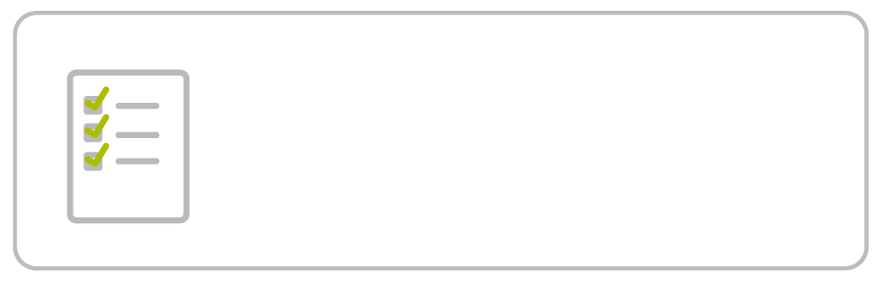
Activity Templates (1 of 2)
1-18 Activity: Identify RTE connections
3-5 Activity: Dunbar’s number
4-18 Activity: RTE and PI Planning schedule, flow, and the RTE role
4-53 Activity: Facilitating a distributed PI Planning
1-20 Activity: The RTE role and responsibilities
3-9 Activity: Your ART team organization
4-25 Activity: Reading the program board in PI Planning
5-5 Activity: The RTE and Iteration execution
1-22 Activity: A typical PI for an RTE
3-15 Activity: Key ART collaboration
4-33 Activity: Management problem-solving meeting
5-11 Activity: The RTE and the ART events
1-26 Activity: Identify effective RTE behaviors
3-18 Activity: Where are the Business Owners?
4-43 Activity: ROAM and program risks
5-19 Activity: Build your own Program Kanban Board
1-29 Activity: Identify the organizational benefits to having an RTE
4-9 Activity: How much preparation is enough?
5-25 Activity: Reading cumulative flow diagrams
4-47 Activity: Confidence not high? Plan rework.
2-6 Activity: Building an RTE and SAFe Principles poster
4-16 Activity: Good enough preparation
4-49 Activity: Running the PI Planning retrospective
Notes:
Trainer Guidance:
This slide shows a list of the activity templates provided in the remote training aid.
The number on each activity represents the lesson number and the slide number in the courseware slides.
Click on the links to quickly access each activity.

Slide 8
Activity Templates (2 of 2)
5-32 Activity: The IP Iteration
6-23 Activity: Root cause analysis
6-45 Activity: Development value stream mapping—future state
7-26 Activity: Demonstrate a facilitation technique
5-46 Activity: Building a SAFe DevOps practice poster
6-26 Activity: Pareto Analysis
6-50 & 51 Activity: The relentless improvement mindset - teach back
7-29 Activity: Build your group facilitation toolbox
5-48 Activity: System increment definition of done (DoD)
6-27 Activity: Restate the new problem
7-6 Activity: The servant leader characteristics
7-36 Activities: Being vulnerable in front of the tribe
5-51 Activity: The definition of done is not done!
6-28 & 29 Activity: Brainstorm potential solution ideas
7-12 Activity: The RTE and ART group dynamics
6-12 Activity: Preparing for PI System Demo and quantitative Metrics
6-36 Activity: Self-assessment tools
7-19 Activity: Powerful questioning
6-19 Activity: Agree on the problem to solve
6-43 Activity: Development value stream mapping—current state
7-22 Activity: The ART can’t run without trust
Notes:
Trainer Guidance:
This slide shows a list of the activity templates provided in the remote training aid.
The number on each activity represents the lesson number and the slide number in the courseware slides.
Click on the links to quickly access each activity.

Slide 9
Wall Charts

Slide 10
Agenda
New
In Process
Done
Lesson 5:
Executing a Program Increment
53
Lesson 1:
Exploring the RTE Role and Responsibilities
31
Lesson 6:
Fostering Relentless Improvement
53
Lesson 2:
Applying SAFe Principles
10
Lesson 7:
Serving the ART
38
Lesson 3:
Organizing the ART
25
Lesson 8:
Continuing Your Learning Journey
15
Lesson 4:
Planning a Program Increment
57
Lesson 9:
Becoming a Certified SAFe Professional
4
Notes:
Trainer Guidance:
The number on the kanban cards is a proxy for size and it’s an equivalent to the number of slides in the lesson.

Slide 11
Remote Working Agreements
Respect your humanness
One conversation at a time
Assume positive intent
Be present
Respect the timeboxes
[Add additional working agreements]

Slide 12
Parking Lot
Clarify xxxx
Question

